Slide 1
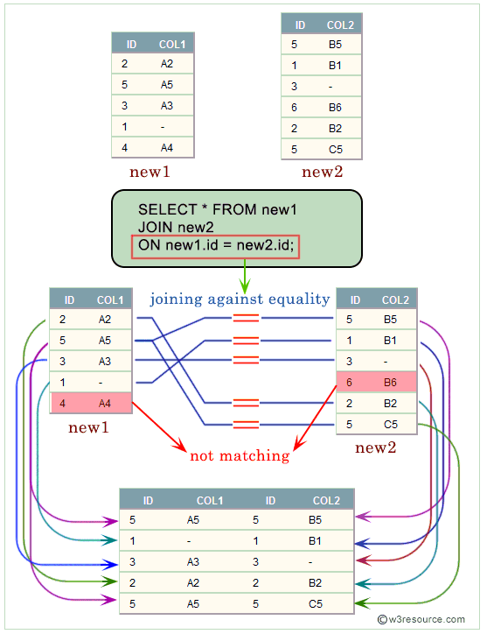
What is Equi Join in SQL?
An Equi Join in SQL is a type of join that combines rows from two or more tables based on a common column or set of columns, using the equality operator = to compare column values.
It is one of the most frequently used types of joins because it matches columns from different tables that have equal values, allowing the combination of related data.
Why are Equi Joins Important?
Equi Joins are crucial for:
Data Integrity: Ensuring only related data from multiple tables is combined.
Query Performance: Optimizing data retrieval by leveraging indexes on join columns.
Data Normalization: Supporting database normalization by joining tables that have been split into logically related entities.
Comparison with Other Joins
While Equi Joins use the equality operator, other joins might use different conditions:
Inner Join: Similar to Equi Join but can use any comparison operator.
Outer Join: Returns all rows from one table and the matched rows from the other.
Cross Join: Combines all rows from both tables, resulting in a Cartesian product.
Natural Join: Automatically joins tables based on columns with the same names and compatible data types.

Slide 2
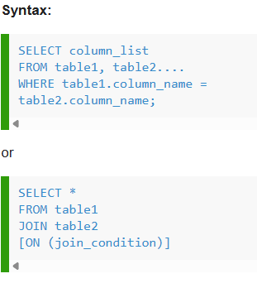

Slide 3
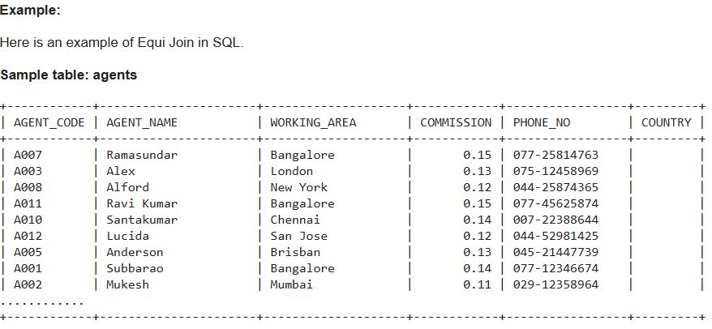
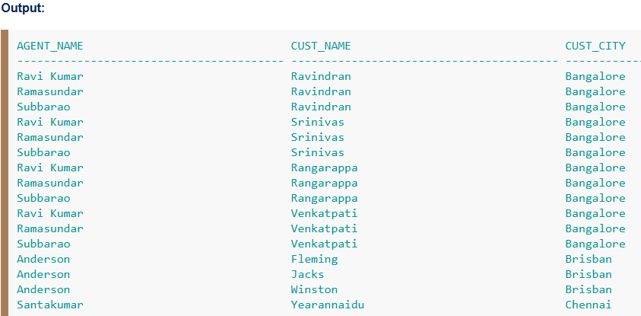
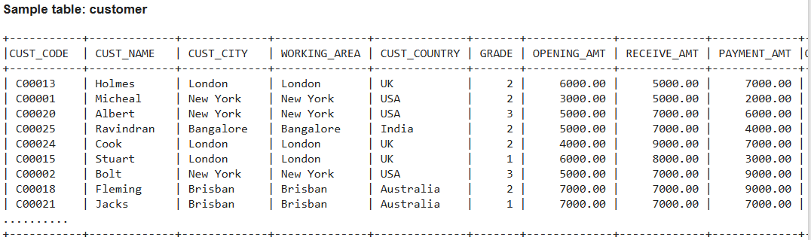
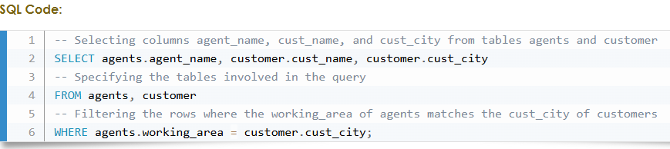
EQUI JOIN

Slide 4
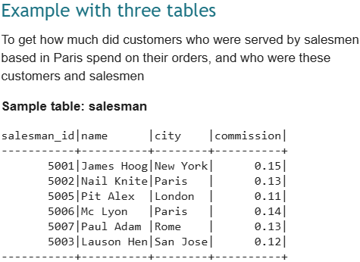
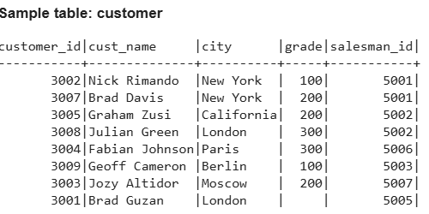
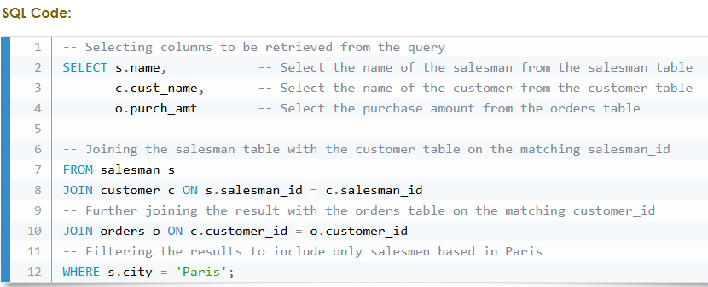
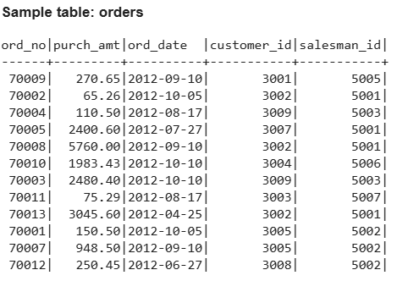

Slide 5
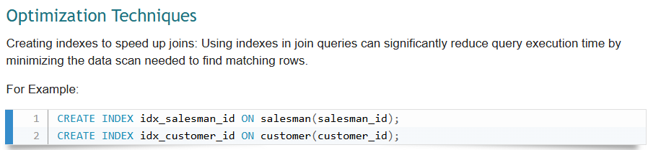

Slide 6
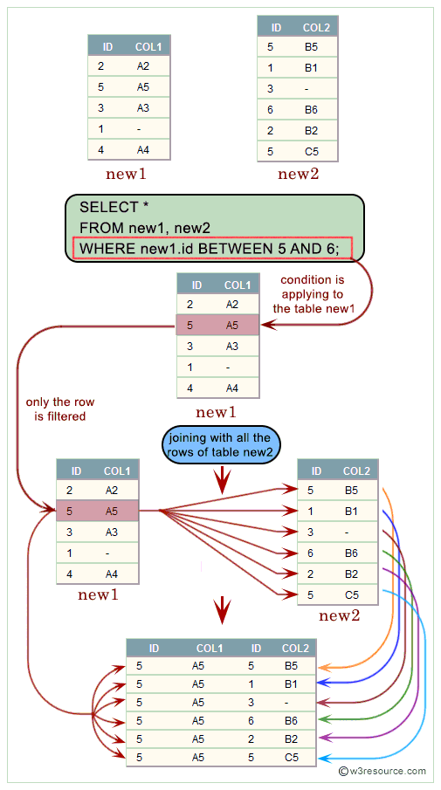
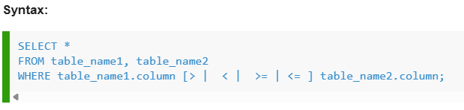
NON EQUI JOIN
The SQL NON EQUI JOIN uses comparison operators instead of the equal sign, like >, <, >=, <= , along with conditions.
Visual presentation of SQL Non-Equi Join:

Slide 7
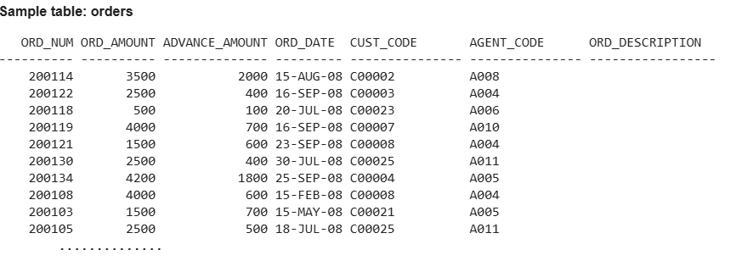
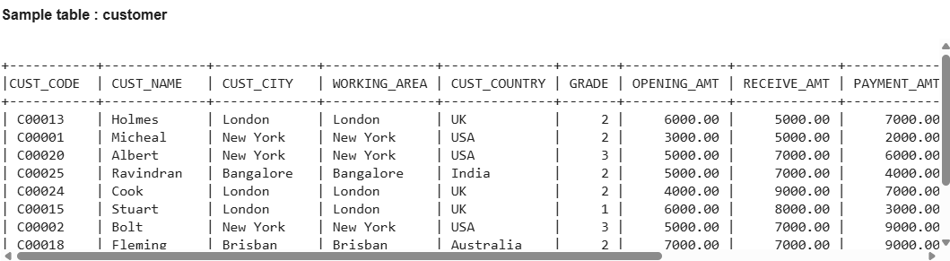
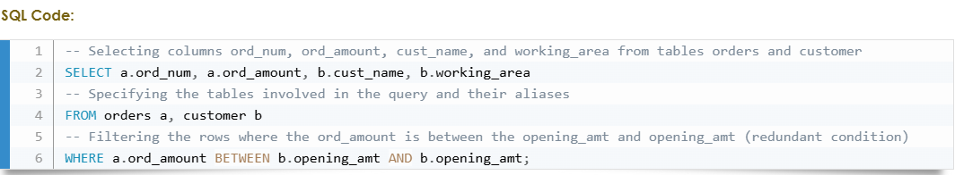
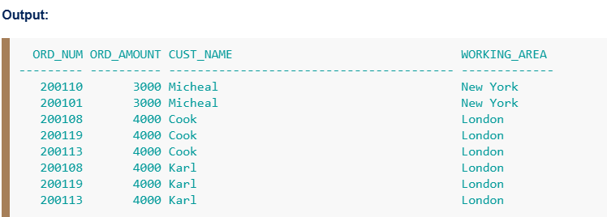
NON EQUI JOIN

Slide 8
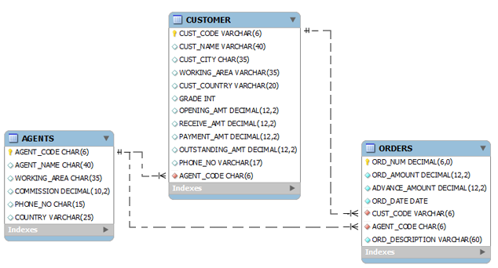

Slide 9
CREATE TABLE "AGENTS"
(
"AGENT_CODE" CHAR(6) NOT NULL PRIMARY KEY,
"AGENT_NAME" CHAR(40),
"WORKING_AREA" CHAR(35),
"COMMISSION" NUMBER(10,2),
"PHONE_NO" CHAR(15),
"COUNTRY" VARCHAR2(25)
);
INSERT INTO AGENTS VALUES ('A007', 'Ramasundar', 'Bangalore', '0.15', '077-25814763', '');
INSERT INTO AGENTS VALUES ('A003', 'Alex ', 'London', '0.13', '075-12458969', '');
INSERT INTO AGENTS VALUES ('A008', 'Alford', 'New York', '0.12', '044-25874365', '');
INSERT INTO AGENTS VALUES ('A011', 'Ravi Kumar', 'Bangalore', '0.15', '077-45625874', '');
INSERT INTO AGENTS VALUES ('A010', 'Santakumar', 'Chennai', '0.14', '007-22388644', '');
INSERT INTO AGENTS VALUES ('A012', 'Lucida', 'San Jose', '0.12', '044-52981425', '');
INSERT INTO AGENTS VALUES ('A005', 'Anderson', 'Brisban', '0.13', '045-21447739', '');
INSERT INTO AGENTS VALUES ('A001', 'Subbarao', 'Bangalore', '0.14', '077-12346674', '');
INSERT INTO AGENTS VALUES ('A002', 'Mukesh', 'Mumbai', '0.11', '029-12358964', '');
INSERT INTO AGENTS VALUES ('A006', 'McDen', 'London', '0.15', '078-22255588', '');
INSERT INTO AGENTS VALUES ('A004', 'Ivan', 'Torento', '0.15', '008-22544166', '');
INSERT INTO AGENTS VALUES ('A009', 'Benjamin', 'Hampshair', '0.11', '008-22536178', '');

Slide 10
CREATE TABLE "CUSTOMER"
( "CUST_CODE" VARCHAR2(6) NOT NULL PRIMARY KEY,
"CUST_NAME" VARCHAR2(40) NOT NULL,
"CUST_CITY" CHAR(35),
"WORKING_AREA" VARCHAR2(35) NOT NULL,
"CUST_COUNTRY" VARCHAR2(20) NOT NULL,
"GRADE" NUMBER,
"OPENING_AMT" NUMBER(12,2) NOT NULL,
"RECEIVE_AMT" NUMBER(12,2) NOT NULL,
"PAYMENT_AMT" NUMBER(12,2) NOT NULL,
"OUTSTANDING_AMT" NUMBER(12,2) NOT NULL,
"PHONE_NO" VARCHAR2(17) NOT NULL,
"AGENT_CODE" CHAR(6) NOT NULL REFERENCES AGENTS
);
INSERT INTO CUSTOMER VALUES ('C00013', 'Holmes', 'London', 'London', 'UK', '2', '6000.00', '5000.00', '7000.00', '4000.00', 'BBBBBBB', 'A003');
INSERT INTO CUSTOMER VALUES ('C00001', 'Micheal', 'New York', 'New York', 'USA', '2', '3000.00', '5000.00', '2000.00', '6000.00', 'CCCCCCC', 'A008');
INSERT INTO CUSTOMER VALUES ('C00020', 'Albert', 'New York', 'New York', 'USA', '3', '5000.00', '7000.00', '6000.00', '6000.00', 'BBBBSBB', 'A008');
INSERT INTO CUSTOMER VALUES ('C00025', 'Ravindran', 'Bangalore', 'Bangalore', 'India', '2', '5000.00', '7000.00', '4000.00', '8000.00', 'AVAVAVA', 'A011');
INSERT INTO CUSTOMER VALUES ('C00024', 'Cook', 'London', 'London', 'UK', '2', '4000.00', '9000.00', '7000.00', '6000.00', 'FSDDSDF', 'A006');
INSERT INTO CUSTOMER VALUES ('C00015', 'Stuart', 'London', 'London', 'UK', '1', '6000.00', '8000.00', '3000.00', '11000.00', 'GFSGERS', 'A003');
INSERT INTO CUSTOMER VALUES ('C00002', 'Bolt', 'New York', 'New York', 'USA', '3', '5000.00', '7000.00', '9000.00', '3000.00', 'DDNRDRH', 'A008');
INSERT INTO CUSTOMER VALUES ('C00018', 'Fleming', 'Brisban', 'Brisban', 'Australia', '2', '7000.00', '7000.00', '9000.00', '5000.00', 'NHBGVFC', 'A005');
INSERT INTO CUSTOMER VALUES ('C00021', 'Jacks', 'Brisban', 'Brisban', 'Australia', '1', '7000.00', '7000.00', '7000.00', '7000.00', 'WERTGDF', 'A005');
INSERT INTO CUSTOMER VALUES ('C00019', 'Yearannaidu', 'Chennai', 'Chennai', 'India', '1', '8000.00', '7000.00', '7000.00', '8000.00', 'ZZZZBFV', 'A010');
INSERT INTO CUSTOMER VALUES ('C00005', 'Sasikant', 'Mumbai', 'Mumbai', 'India', '1', '7000.00', '11000.00', '7000.00', '11000.00', '147-25896312', 'A002');
INSERT INTO CUSTOMER VALUES ('C00007', 'Ramanathan', 'Chennai', 'Chennai', 'India', '1', '7000.00', '11000.00', '9000.00', '9000.00', 'GHRDWSD', 'A010');
INSERT INTO CUSTOMER VALUES ('C00022', 'Avinash', 'Mumbai', 'Mumbai', 'India', '2', '7000.00', '11000.00', '9000.00', '9000.00', '113-12345678','A002');
INSERT INTO CUSTOMER VALUES ('C00004', 'Winston', 'Brisban', 'Brisban', 'Australia', '1', '5000.00', '8000.00', '7000.00', '6000.00', 'AAAAAAA', 'A005');
INSERT INTO CUSTOMER VALUES ('C00023', 'Karl', 'London', 'London', 'UK', '0', '4000.00', '6000.00', '7000.00', '3000.00', 'AAAABAA', 'A006');
INSERT INTO CUSTOMER VALUES ('C00006', 'Shilton', 'Torento', 'Torento', 'Canada', '1', '10000.00', '7000.00', '6000.00', '11000.00', 'DDDDDDD', 'A004');
INSERT INTO CUSTOMER VALUES ('C00010', 'Charles', 'Hampshair', 'Hampshair', 'UK', '3', '6000.00', '4000.00', '5000.00', '5000.00', 'MMMMMMM', 'A009');
INSERT INTO CUSTOMER VALUES ('C00017', 'Srinivas', 'Bangalore', 'Bangalore', 'India', '2', '8000.00', '4000.00', '3000.00', '9000.00', 'AAAAAAB', 'A007');
INSERT INTO CUSTOMER VALUES ('C00012', 'Steven', 'San Jose', 'San Jose', 'USA', '1', '5000.00', '7000.00', '9000.00', '3000.00', 'KRFYGJK', 'A012');
INSERT INTO CUSTOMER VALUES ('C00008', 'Karolina', 'Torento', 'Torento', 'Canada', '1', '7000.00', '7000.00', '9000.00', '5000.00', 'HJKORED', 'A004');
INSERT INTO CUSTOMER VALUES ('C00003', 'Martin', 'Torento', 'Torento', 'Canada', '2', '8000.00', '7000.00', '7000.00', '8000.00', 'MJYURFD', 'A004');
INSERT INTO CUSTOMER VALUES ('C00009', 'Ramesh', 'Mumbai', 'Mumbai', 'India', '3', '8000.00', '7000.00', '3000.00', '12000.00', 'Phone No', 'A002');
INSERT INTO CUSTOMER VALUES ('C00014', 'Rangarappa', 'Bangalore', 'Bangalore', 'India', '2', '8000.00', '11000.00', '7000.00', '12000.00', 'AAAATGF', 'A001');
INSERT INTO CUSTOMER VALUES ('C00016', 'Venkatpati', 'Bangalore', 'Bangalore', 'India', '2', '8000.00', '11000.00', '7000.00', '12000.00', 'JRTVFDD', 'A007');
INSERT INTO CUSTOMER VALUES ('C00011', 'Sundariya', 'Chennai', 'Chennai', 'India', '3', '7000.00', '11000.00', '7000.00', '11000.00', 'PPHGRTS', 'A010');

Slide 11
CREATE TABLE "ORDERS"
(
"ORD_NUM" NUMBER(6,0) NOT NULL PRIMARY KEY,
"ORD_AMOUNT" NUMBER(12,2) NOT NULL,
"ADVANCE_AMOUNT" NUMBER(12,2) NOT NULL,
"ORD_DATE" DATE NOT NULL,
"CUST_CODE" VARCHAR2(6) NOT NULL REFERENCES CUSTOMER,
"AGENT_CODE" CHAR(6) NOT NULL REFERENCES AGENTS,
"ORD_DESCRIPTION" VARCHAR2(60) NOT NULL
);
INSERT INTO ORDERS VALUES('200100', '1000.00', '600.00', '08/01/2008', 'C00013', 'A003', 'SOD');
INSERT INTO ORDERS VALUES('200110', '3000.00', '500.00', '04/15/2008', 'C00019', 'A010', 'SOD');
INSERT INTO ORDERS VALUES('200107', '4500.00', '900.00', '08/30/2008', 'C00007', 'A010', 'SOD');
INSERT INTO ORDERS VALUES('200112', '2000.00', '400.00', '05/30/2008', 'C00016', 'A007', 'SOD');
INSERT INTO ORDERS VALUES('200113', '4000.00', '600.00', '06/10/2008', 'C00022', 'A002', 'SOD');
INSERT INTO ORDERS VALUES('200102', '2000.00', '300.00', '05/25/2008', 'C00012', 'A012', 'SOD');
INSERT INTO ORDERS VALUES('200114', '3500.00', '2000.00', '08/15/2008', 'C00002', 'A008', 'SOD');
INSERT INTO ORDERS VALUES('200122', '2500.00', '400.00', '09/16/2008', 'C00003', 'A004', 'SOD');
INSERT INTO ORDERS VALUES('200118', '500.00', '100.00', '07/20/2008', 'C00023', 'A006', 'SOD');
INSERT INTO ORDERS VALUES('200119', '4000.00', '700.00', '09/16/2008', 'C00007', 'A010', 'SOD');
INSERT INTO ORDERS VALUES('200121', '1500.00', '600.00', '09/23/2008', 'C00008', 'A004', 'SOD');
INSERT INTO ORDERS VALUES('200130', '2500.00', '400.00', '07/30/2008', 'C00025', 'A011', 'SOD');
INSERT INTO ORDERS VALUES('200134', '4200.00', '1800.00', '09/25/2008', 'C00004', 'A005', 'SOD');
INSERT INTO ORDERS VALUES('200108', '4000.00', '600.00', '02/15/2008', 'C00008', 'A004', 'SOD');
INSERT INTO ORDERS VALUES('200103', '1500.00', '700.00', '05/15/2008', 'C00021', 'A005', 'SOD');
INSERT INTO ORDERS VALUES('200105', '2500.00', '500.00', '07/18/2008', 'C00025', 'A011', 'SOD');
INSERT INTO ORDERS VALUES('200109', '3500.00', '800.00', '07/30/2008', 'C00011', 'A010', 'SOD');
INSERT INTO ORDERS VALUES('200101', '3000.00', '1000.00', '07/15/2008', 'C00001', 'A008', 'SOD');
INSERT INTO ORDERS VALUES('200111', '1000.00', '300.00', '07/10/2008', 'C00020', 'A008', 'SOD');
INSERT INTO ORDERS VALUES('200104', '1500.00', '500.00', '03/13/2008', 'C00006', 'A004', 'SOD');
INSERT INTO ORDERS VALUES('200106', '2500.00', '700.00', '04/20/2008', 'C00005', 'A002', 'SOD');
INSERT INTO ORDERS VALUES('200125', '2000.00', '600.00', '10/10/2008', 'C00018', 'A005', 'SOD');
INSERT INTO ORDERS VALUES('200117', '800.00', '200.00', '10/20/2008', 'C00014', 'A001', 'SOD');
INSERT INTO ORDERS VALUES('200123', '500.00', '100.00', '09/16/2008', 'C00022', 'A002', 'SOD');
INSERT INTO ORDERS VALUES('200120', '500.00', '100.00', '07/20/2008', 'C00009', 'A002', 'SOD');
INSERT INTO ORDERS VALUES('200116', '500.00', '100.00', '07/13/2008', 'C00010', 'A009', 'SOD');
INSERT INTO ORDERS VALUES('200124', '500.00', '100.00', '06/20/2008', 'C00017', 'A007', 'SOD');
INSERT INTO ORDERS VALUES('200126', '500.00', '100.00', '06/24/2008', 'C00022', 'A002', 'SOD');
INSERT INTO ORDERS VALUES('200129', '2500.00', '500.00', '07/20/2008', 'C00024', 'A006', 'SOD');
INSERT INTO ORDERS VALUES('200127', '2500.00', '400.00', '07/20/2008', 'C00015', 'A003', 'SOD');
INSERT INTO ORDERS VALUES('200128', '3500.00', '1500.00', '07/20/2008', 'C00009', 'A002', 'SOD');
INSERT INTO ORDERS VALUES('200135', '2000.00', '800.00', '09/16/2008', 'C00007', 'A010', 'SOD');
INSERT INTO ORDERS VALUES('200131', '900.00', '150.00', '08/26/2008', 'C00012', 'A012', 'SOD');
INSERT INTO ORDERS VALUES('200133', '1200.00', '400.00', '06/29/2008', 'C00009', 'A002', 'SOD');

Slide 12
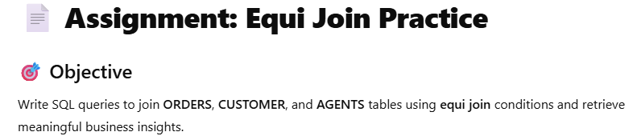

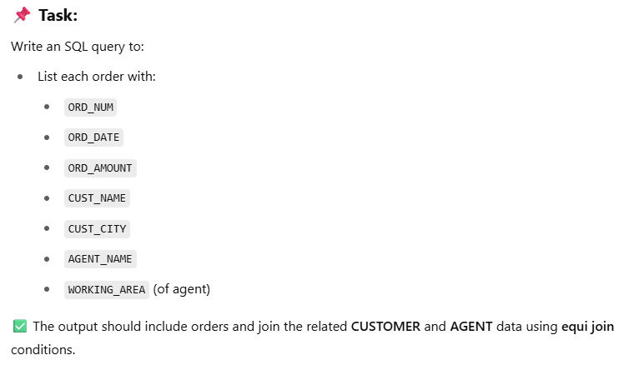
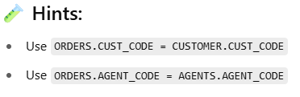

Slide 13
